Slide 1

P03-2024
HHP YL COACHING
Presenter: Precious Alegria
Date: March 22, 2024 (w4d5)

Slide 2
Contents
YL Trends
Product Reminder
Other Concern

Slide 3

YL Trends

Slide 4
TRENDS
HIGHLIGHTS - YL down by 3% vs P01 2024
Top 5 Error Type
1) Expected YL
2) Blank
3) Variant Formula
4) Unit Price
5) All Field/Multiple Field

Slide 5
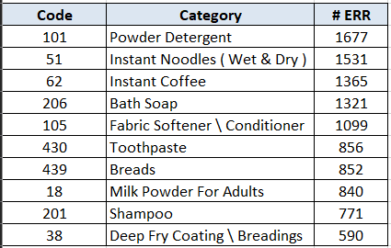
TRENDS
Top 10 Categories P02-YL

Slide 6
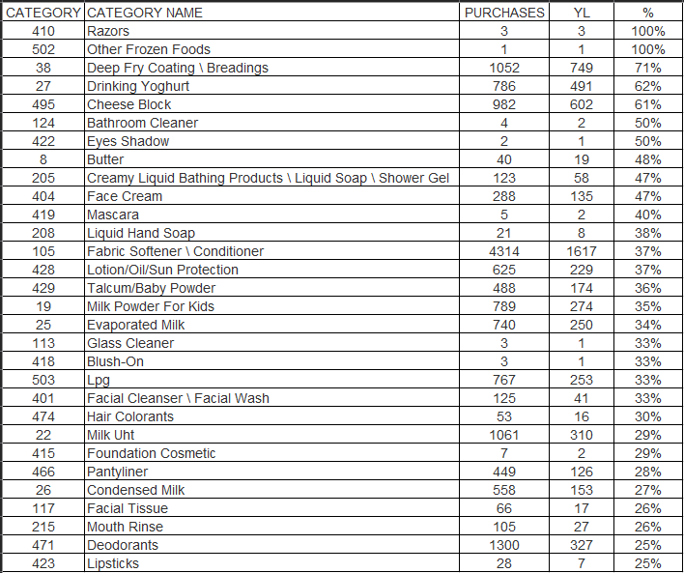
P02-YL VERIFICATION
Of the 199 categories encoded, 87% have YL verification.

Slide 7
YL FEEDBACK TREND

Slide 8
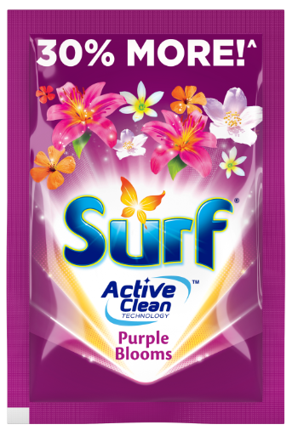
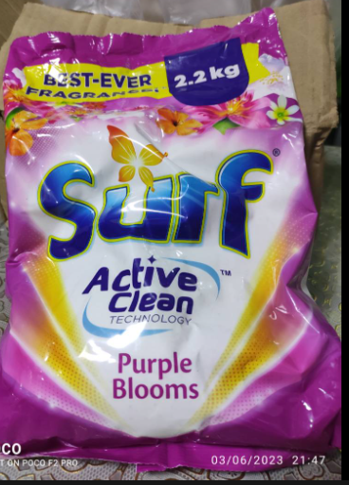
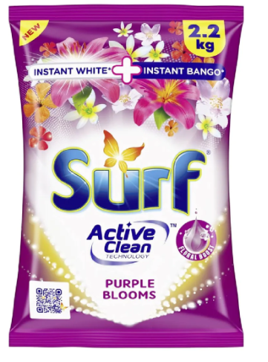
SURF
NEW

Slide 9
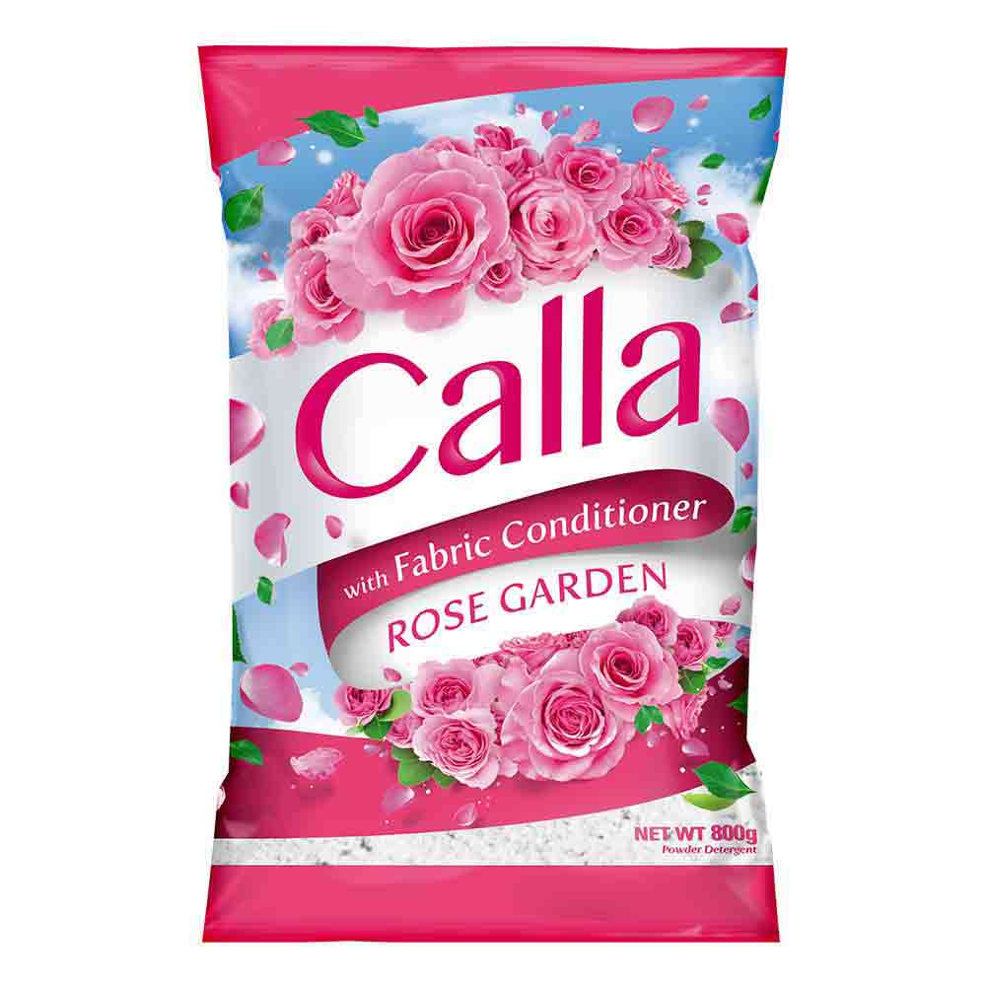
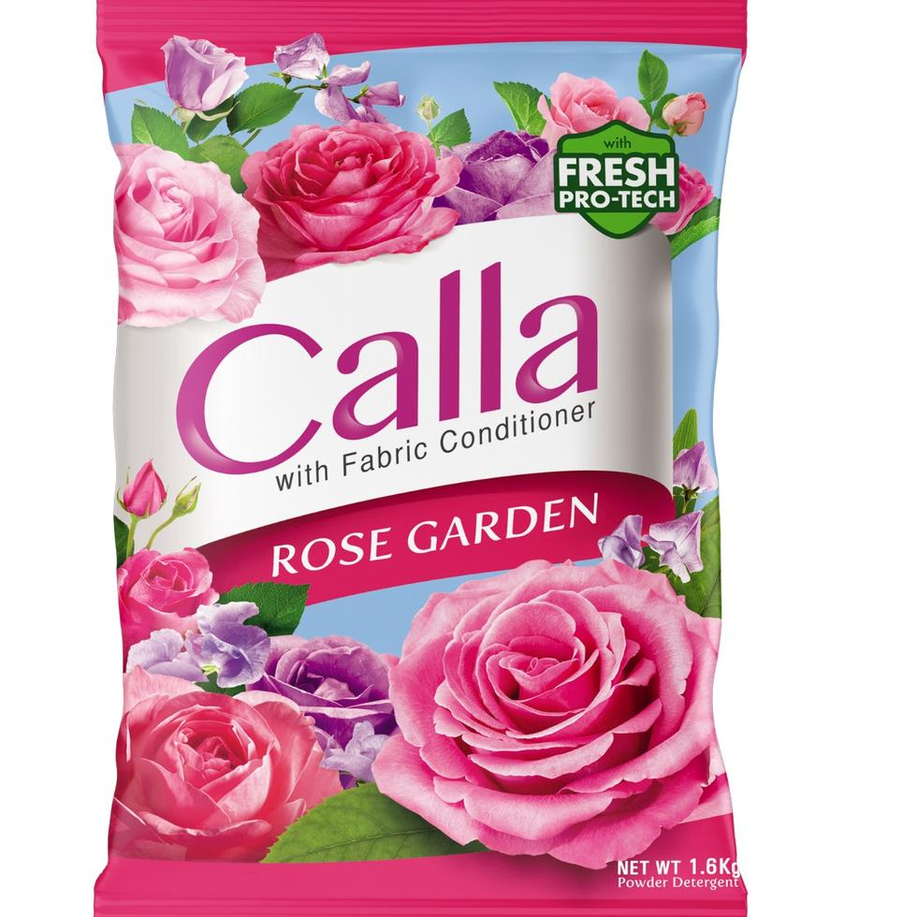
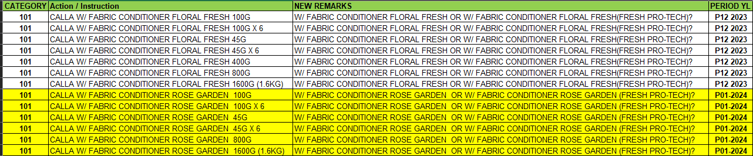
CALLA
NEW

Slide 10
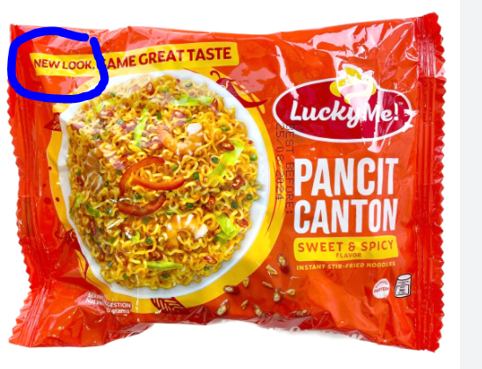
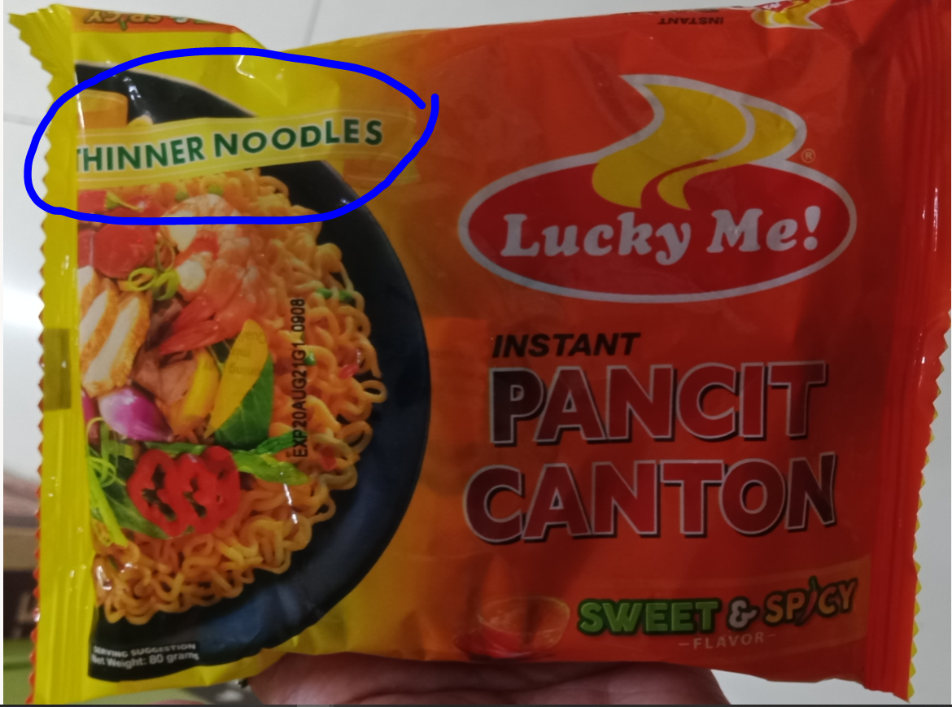
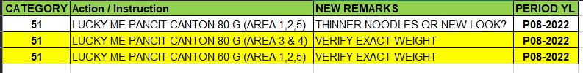
LUCKY ME

Slide 11
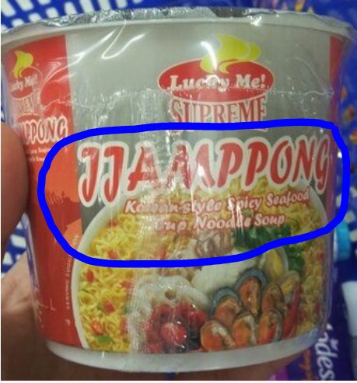
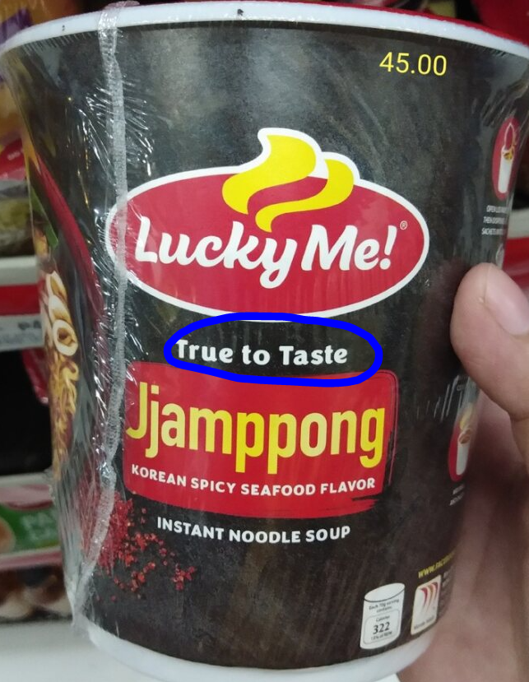
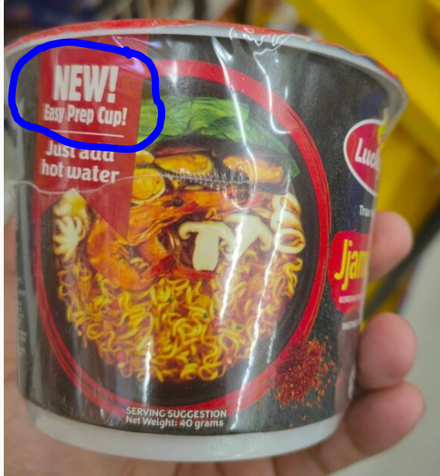
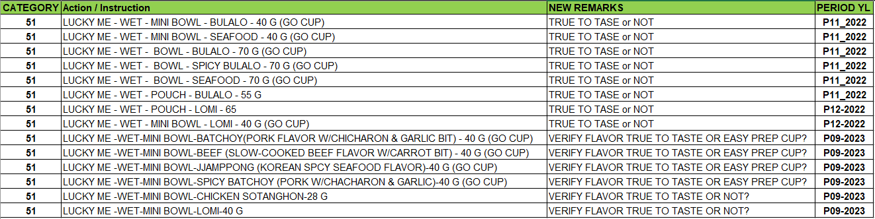
LUCKY ME
NEW

Slide 12
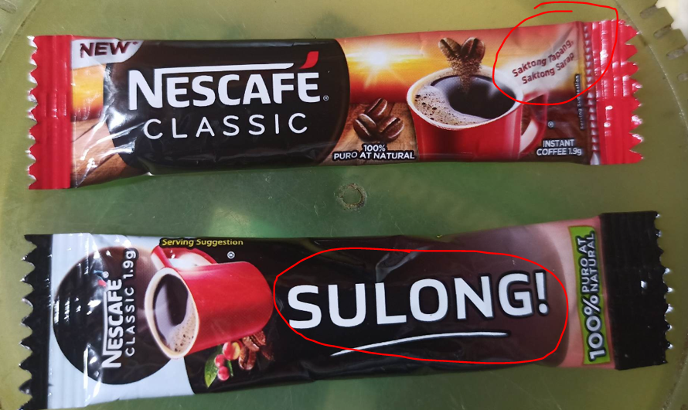
NESCAFE – 1.9G
NEW

Slide 13
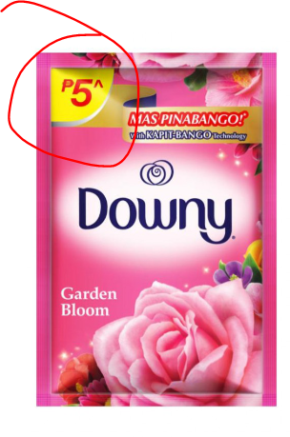
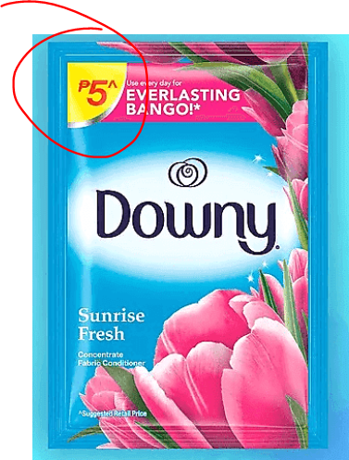
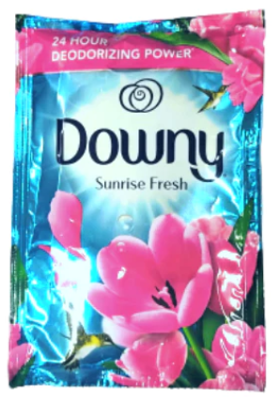
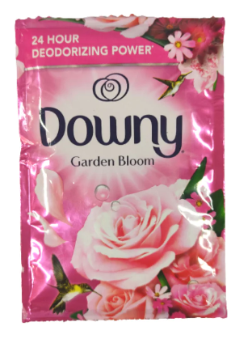
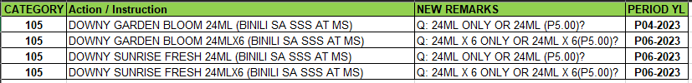
DOWNY – SINGLE SACHET
NEW
NEW

Slide 14
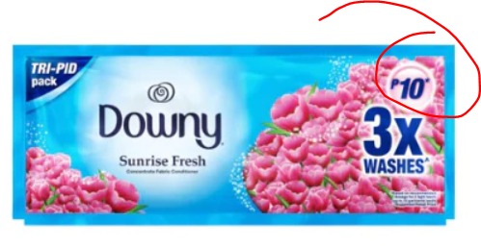
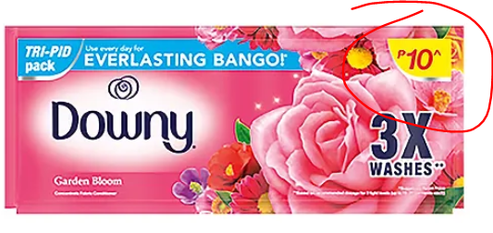
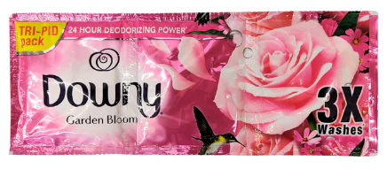
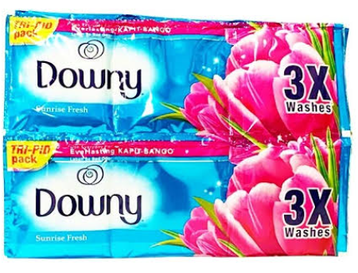

DOWNY – TRIPLE SACHET
NEW
NEW
NEW

Slide 15
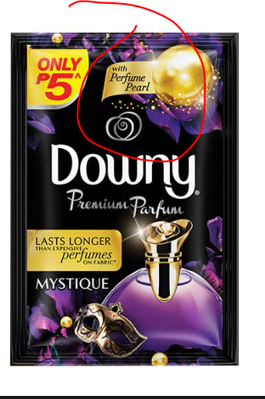
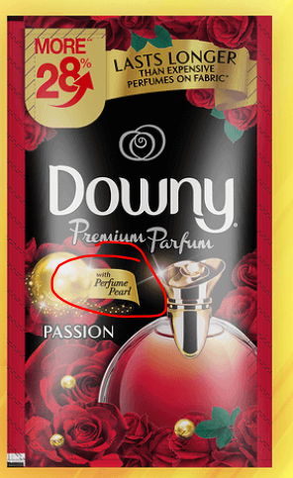
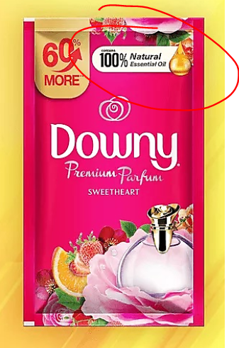
DOWNY PREMIUM PARFUM
NEW
NEW
NEW

Slide 16
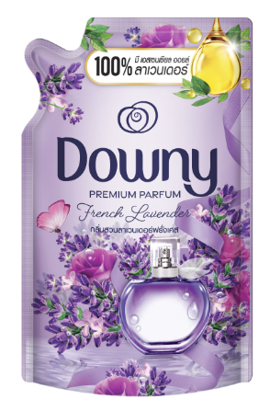
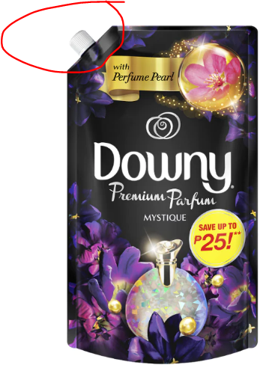
DOWNY – DOY PACK

Slide 17

Product Reminder

Slide 18
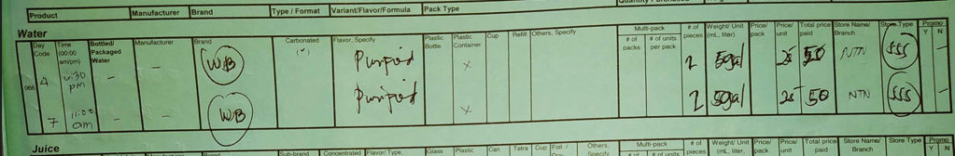
066 - WB BRAND | OUTLET = WATER EFIILING STATION

Slide 19
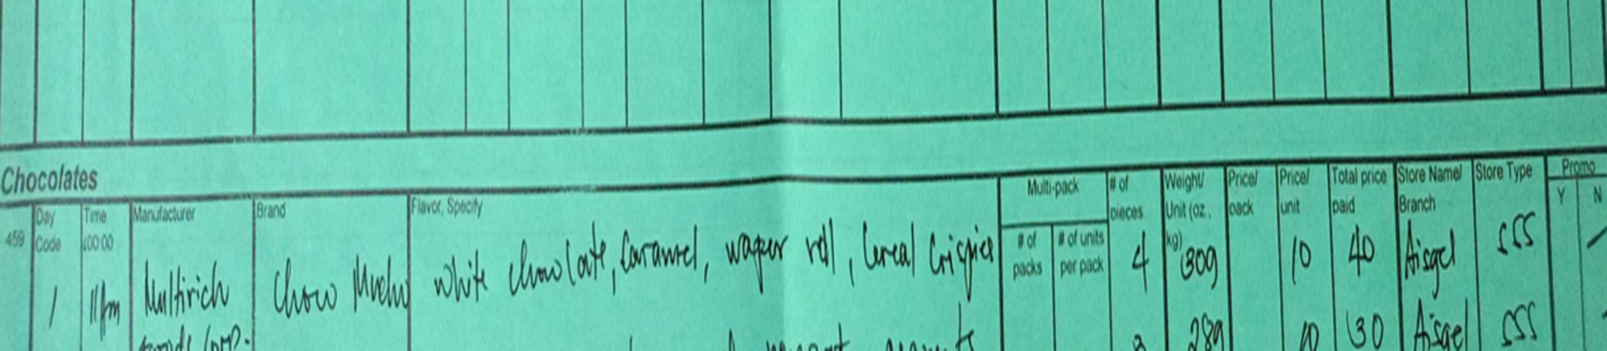
CHOCO MUCHO SINUSULAT SA CATEGORY 459

Slide 20
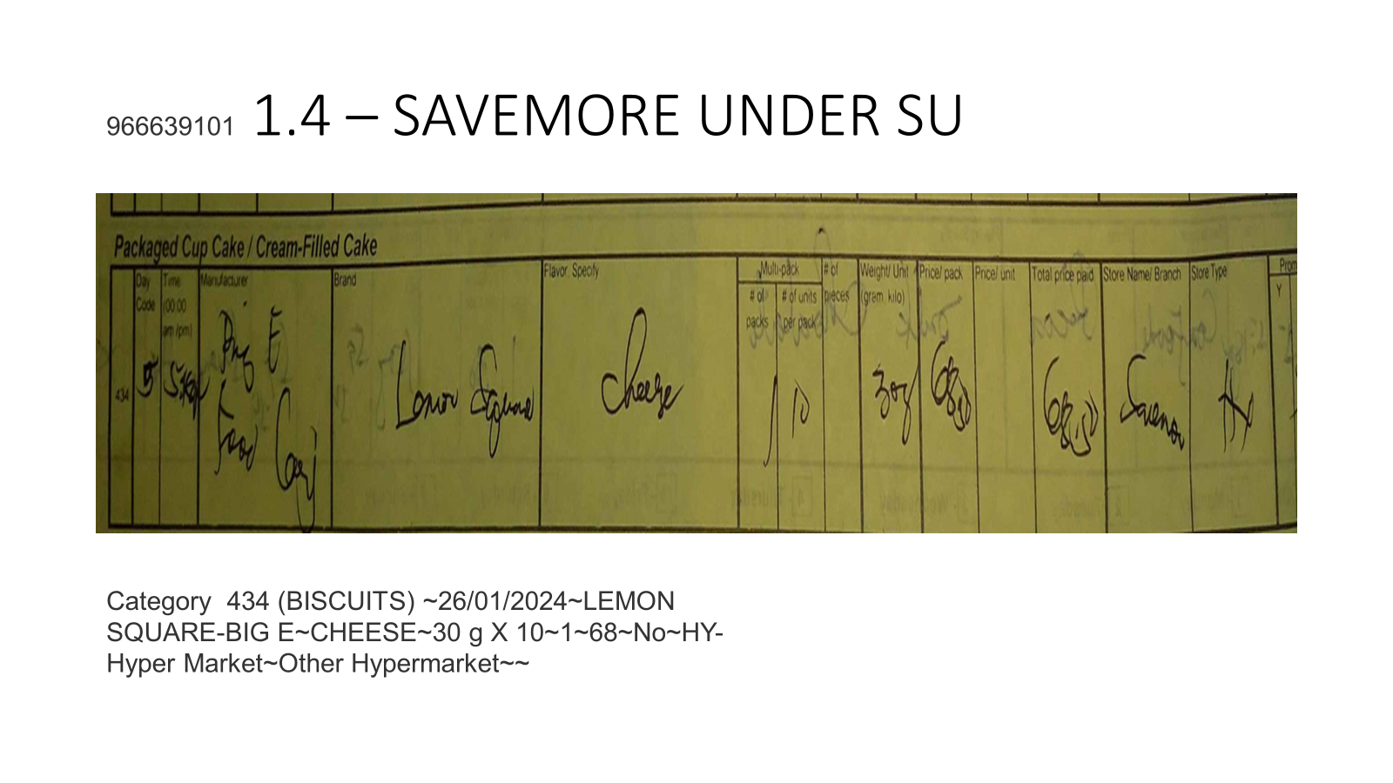
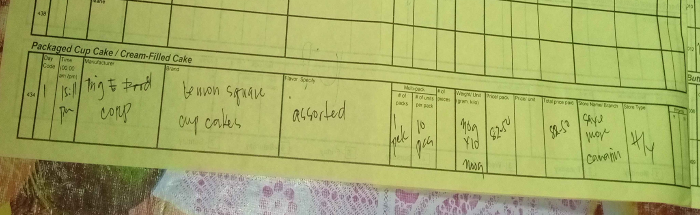

Slide 21
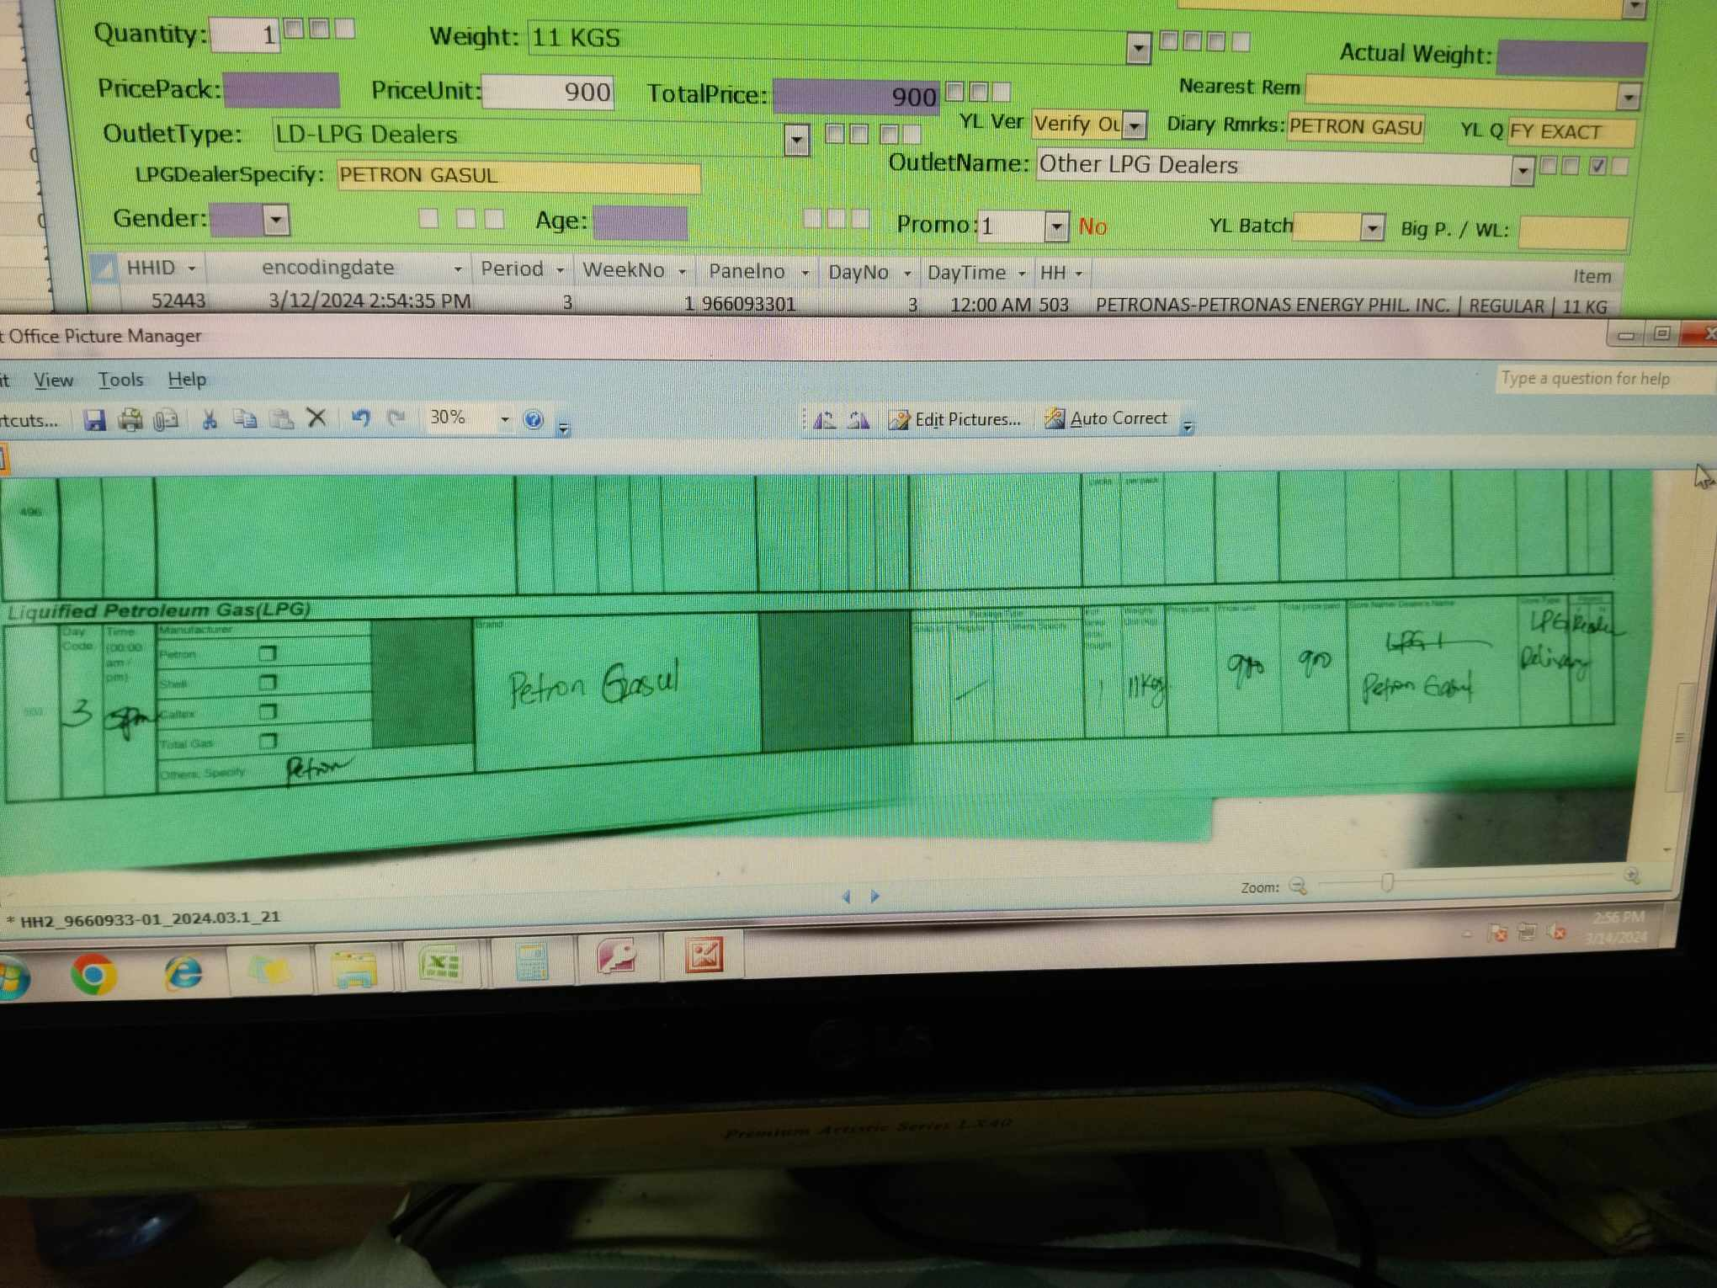
EXACT OUTLET?

Slide 22
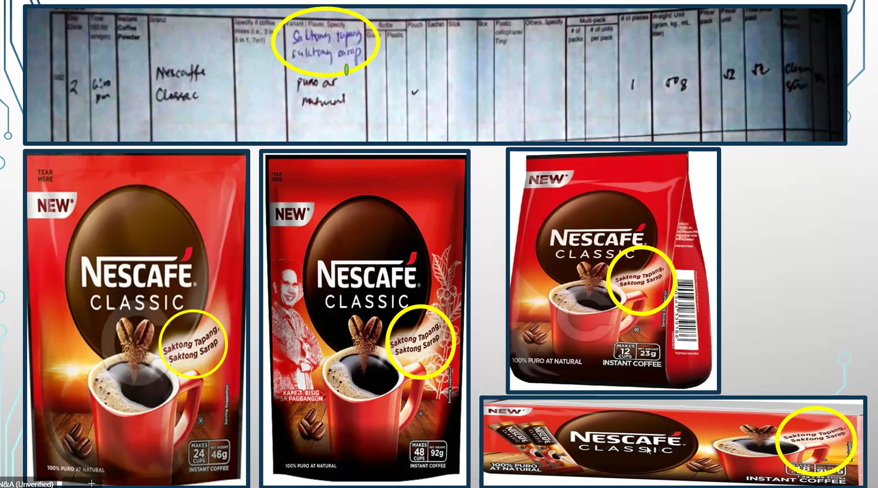

Slide 23
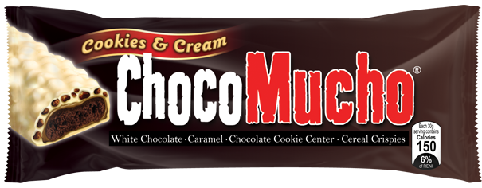
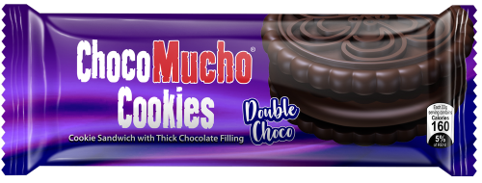
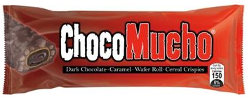
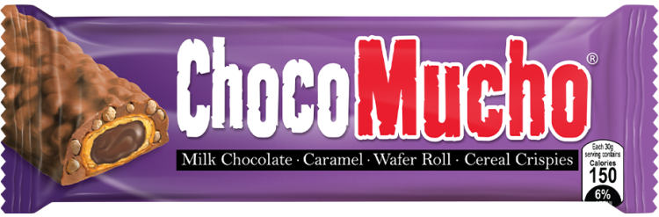
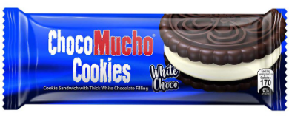
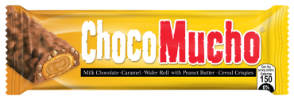
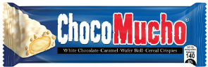
CHOCO MUCHO
433
436
COOKIES & CREAM
DOUBLE CHOCO
COOKIE SANDWICH WITH THICK CHOCOLATE FILLING
DARK CHOCOLATE CARAMEL
MILK CHOCOLATE CARAMEL
WHITE CHOCO
COOKIE SANDWICH WITH THICK WHITE CHOCOLATE FILLING
MILK CHOCOLATE CARAMEL W/ PEANUT BUTTER
WHITE CHOCOLATE CARAMEL CRISPIES

Slide 24
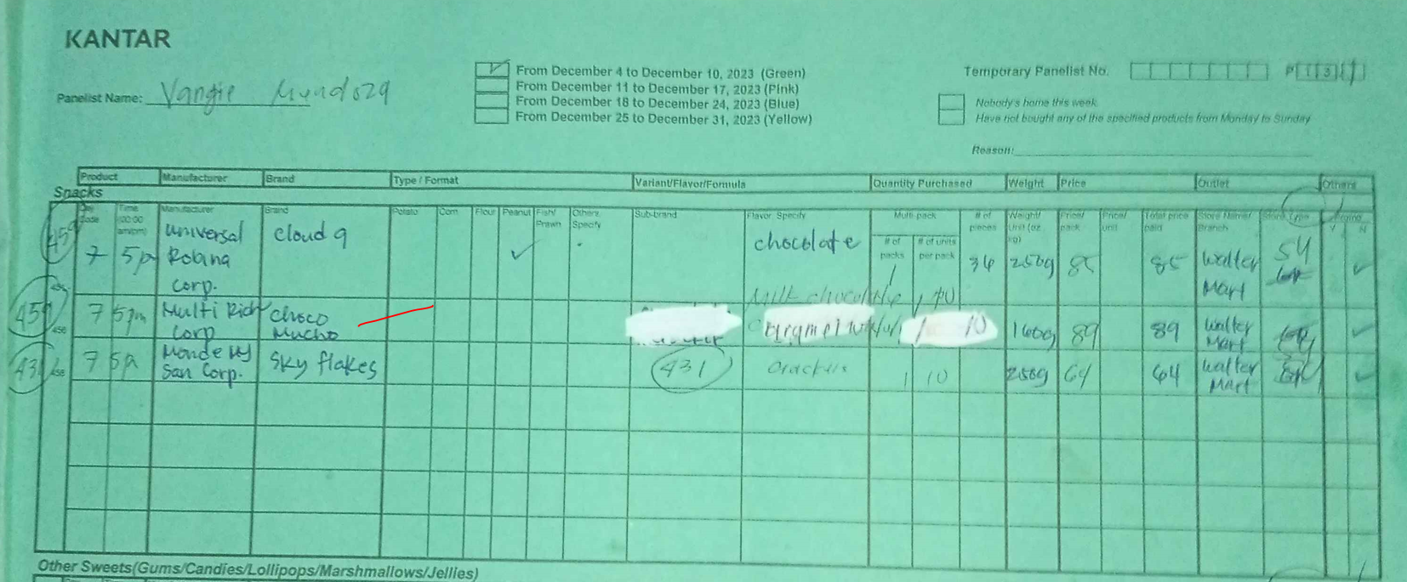
CHOCO MUCHO
Recording of choco mucho should be on page 2, 436 category

Slide 25
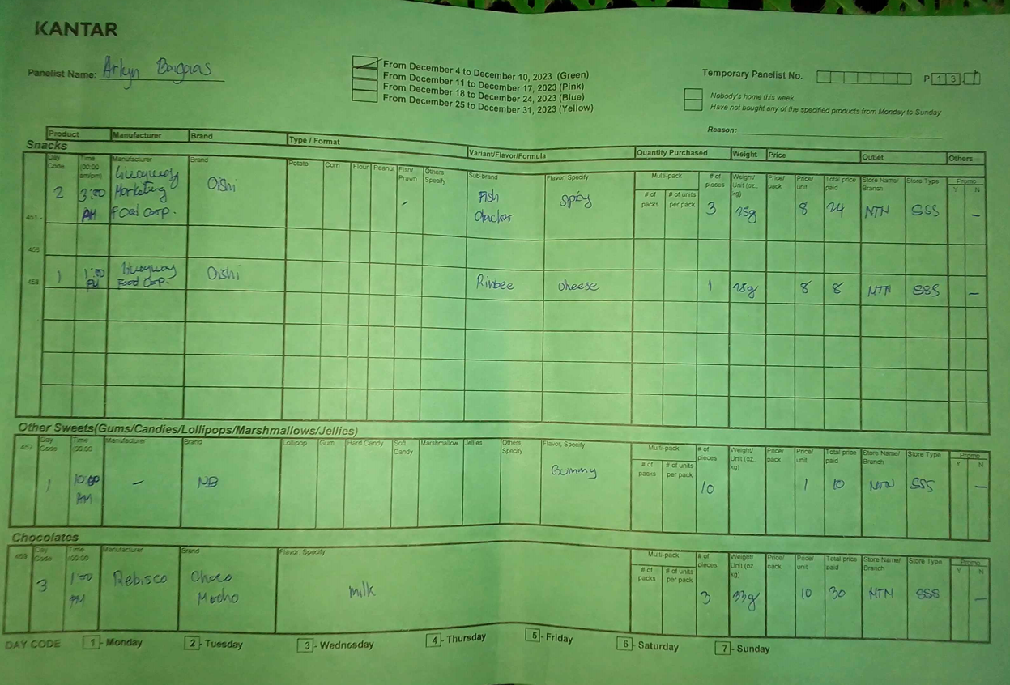
CHOCO MUCHO
Recording of choco mucho should be on page 2, 436 category

Slide 26
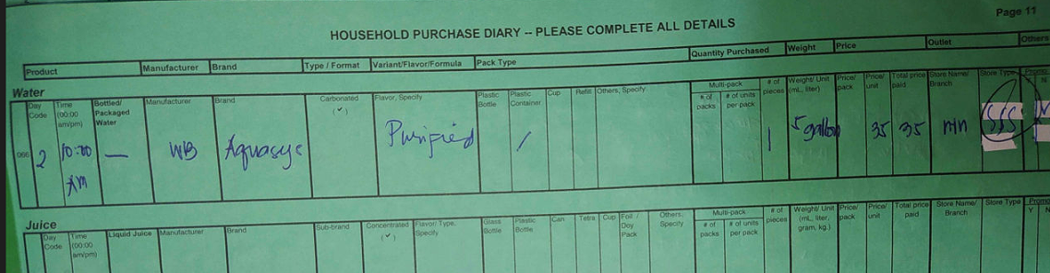
Dapat cgro hindi WB – N/A NALANG OR blanc nalang pag walang manuf kasi na e-encode siya sa WB

Slide 27
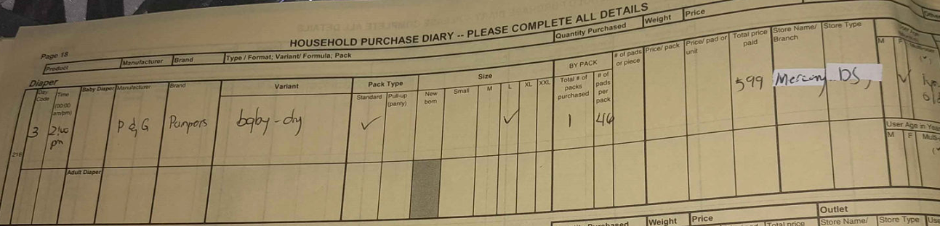
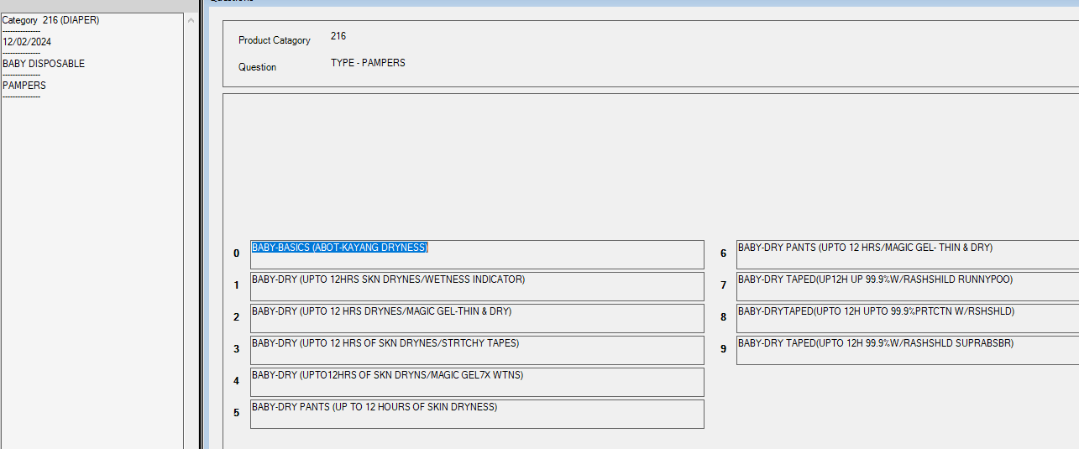
Need e complete ang formula -

Slide 28
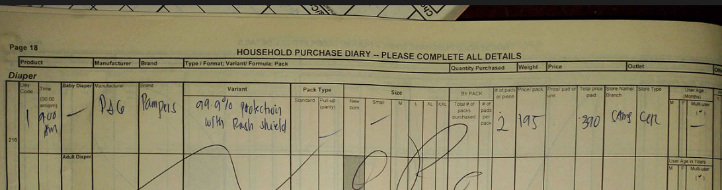
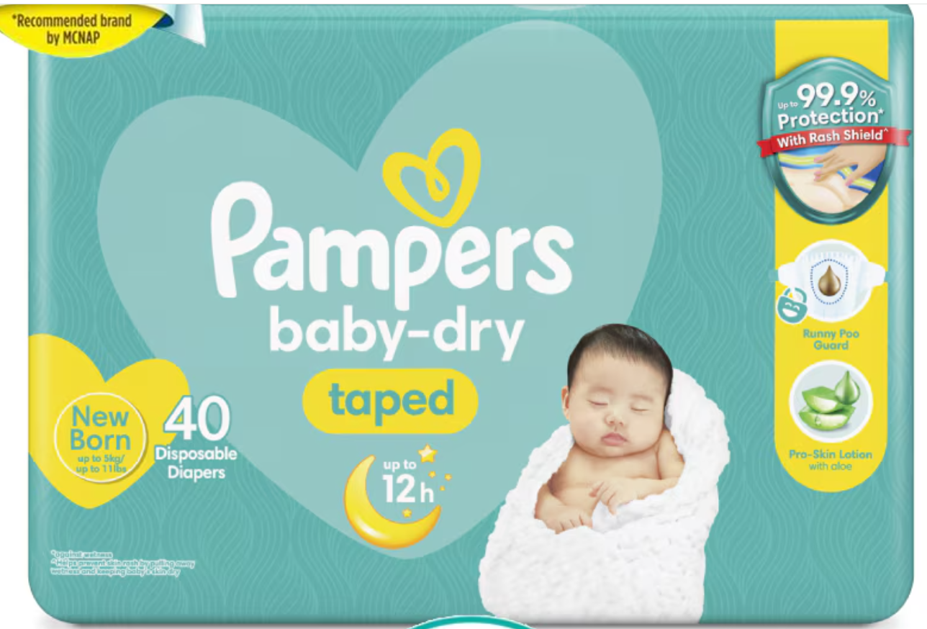

Dapat po complete ang formula para hindi ma Tag as Yellow label

Slide 29



YL–Exact formula
-Max pinabango -or –Pure white (KILLS 99.9% GERMS)

Slide 30


YL – Silang dalawa saka iba ang formula ni ARTIC FRESH

Slide 31


YL parin kahit may bilog kasi po kulang ang sinulat na fragrance

Slide 32




Pag Deo Spray Code 471

Slide 33


Slide 34


Slide 35


Slide 36

YL CONCERN:
1. SHOPWISE INTERNATIONAL - REQUESTING OUTLET PHOTO PO
Q: MERON NA PO ITO SA OTHER AREA BUKOD SA NCR?
2. ALL DIRECT SELLING BRANDS NA NABILI SA SARI SARI STORE AT MARKET STALL WILL BE YL
Q: VERIFY OUTLET IF DEALER SIYA NG DIRECT SELLING AT MAY TINDAHAN?
3. NESCAFE GOLD ONLY
MARAMI PONG TYPE ANG NESCAFE GOLD - PLEASE PAKISULAT PO ANG COMPLETE TYPE AT FLAVORS
SA ANSWERING NAMAN PO NG YL- MAKE SURE PO NA TAMA ANG TYPE VS FLAVOR VS WEIGHT & PRICE
4. NESCAFE DOYPACK RESEALABLE -NO NEED TO YL NA - INCASE MAY MAENCOUNTER PA PO PAKICOLLATE AT FORWARD PO SA DV
5.COFFEEMATEDOYPACK RESEALABLE -NO NEED TO YL NA - INCASE MAY MAENCOUNTER PA PO PAKICOLLATE AT FORWARD PO SA DV
6. BOUNTY FRESH VS SSS /MARKET STALL - MAY SUMASAGOT PO NG VERIFIED NITO SA YL
PWEDE PO KAMI MAKAHINGI NG OUTLET PICTURES? PARA MAALIS NA PO NAMIN SA YL

Slide 37


YL – CONCERN:
7. RCS SUPERMARKET - Q: SAME PO ITO NG RED CAMIA OR RCS SUPERMARKET PO SIYA?
PWEDE PO KAMI MAKAHINGI NG OUTLET PICTURE?
8. ENCOUNTERED LAST PERIOD - ANO PONG NOTATION PAANO PO NAGING VERIFIED ANG OUTLET? FROM DALI GROCERY PO KASI ITO

Slide 38

OTHER CONCERN

Slide 39
OTHER CONCERN:
WL DATA FORMAT WILL SEND AS YL VERIFICATION
YL VERIFICATION SHOULD BE TAG AS NOT YL IF IT IS NOT YL
WL WEIGHT SHOULD BE YL STARTING P04

Slide 40


Slide 41


Slide 42


